Slide 1
LogicFusion’s Hands-on Robotics EV3 Level 2!
Welcome to

Slide 2
Orientation Agenda
General class rules
8 weeks summary
Evaluations
LogicFusion Website

Slide 3

Introductions
Tell us something about you!
What is your name?
Which school are you from?
What grade are you in?
Why are you taking this course?
What’s your favourite thing about robotics so far?
One unique fact!

Slide 4

General Class Rules
Respect
Talking
Asking Questions
Participation
Absences
Working with Lego

Slide 5
Respect
Respect the instructor
Do what’s being asked
Respect fellow classmates
Encourage each other
Give everyone a chance to participate
No putdowns
Make the classroom safe and inclusive! ☺

Slide 6
Talking
Please pay attention when the instructor is speaking
Stop what you are doing and listen attentively
Turn off the monitor
Don’t speak when someone else is speaking
Remember, when you are talking, everyone else listens!

Slide 7
Asking Questions
Please raise your hand
Wait until you are picked
Don’t interrupt others
Ask your questions after class (or during free work time) when:
Your question takes long to answer
You have many questions
Your question is unrelated to what is being taught

Slide 8

Participation
Please raise your hand
Wait until you are picked
Don’t shout out your answer
Participation is strongly encouraged!

Slide 9
Absences
Let the instructor know one class before you are going to be absent
If it is an unexpected absence, let the instructor know as soon as possible

Slide 10
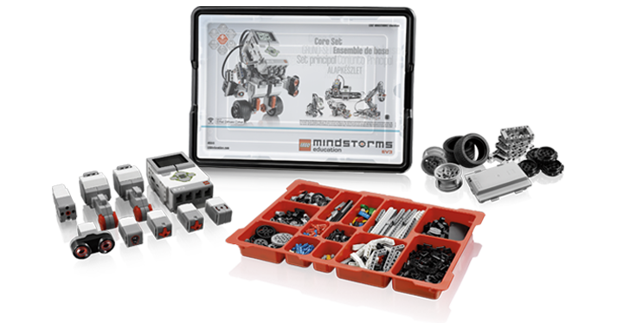
Working with the Lego
Keep your workspace clean
Be careful with the pieces
Don’t force any of the pieces in
Ask if you aren’t sure
Pick up any dropped pieces
Tidy up the box like how you found it
Have fun!

Slide 11
8 Weeks Summary
Logistics, Interface, Motors, & Base Car
Wait, Loops, & Top Spinner
Sound Block & Sensors
Colour Sensor & Switches
Buffalo Bumper Car & Door Alarm
My Block & Mini Rover
Mini Golf & Challenge
Final Project: Design a Robot!
Notes:
Week 1: Interface, Motors, Base Car
Week 2: Wait, Loop, Top Spinner
Week 3: Sound Block, Sensors
Week 4: Colour Sensor, Switches
Week 5: Buffalo Bumper Car, Door Alarm
Week 6: My Block, Mini Rover
Week 7: Mini Golf, Challenge
Week 8: Design a Robot

Slide 12


Evaluations – Grading
You will be graded on the final project
You must obtain 60% or above in order to achieve a certificate or course badge

Slide 13

LogicFusion Account
http://www.logicfusion.ca/users/signup
Please sign up for an account! (Add the course if you were a previous student)
Sign up code: LogicFusionSignup789
Your certificate will be printed based on the first and last name of your account, so PLEASE USE YOUR REAL NAME!
Notes:
INSTRUCTORS PLEASE VERIFY THAT ALL STUDENTS HAVE ACHIEVED THE EV3 BADGE.
INSTRUCTORS PLEASE DO NOT SKIP THIS. If you don’t have access to wifi, use the sign up program!

Slide 14
An Introduction
Hands-on Robotics EV3 Level 2, Week 1

Slide 15
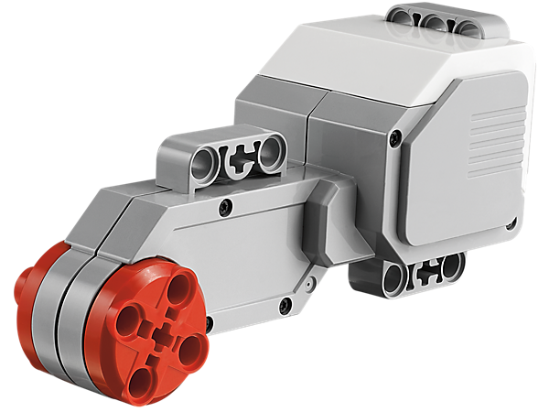
Motors
Notes:
This is a motor. It’s like the motors in our cars that make the wheels turn.
This motor can measure exact distance and speed.
What do motors do?
Takes electric signals and transforms it into a form of motion
Unlike sensors which are input which takes information in, motors are output which produce some output. They act like printers or monitors for our computer.
Image Source: http://cache.lego.com/e/dynamic/is/image/LEGO/45502?$main$

Slide 16
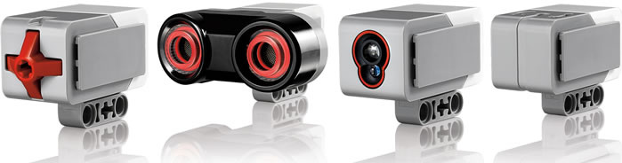
Sensors
Notes:
These are sensors. Touch, Ultrasonic, Light, Gyroscope
Sensors are used to give inputs to the robot, different from the motors being outputs.
Image Source: http://www.ucalgary.ca/IOSTEM/files/IOSTEM/media_crop/44/public/sensors.jpg

Slide 17
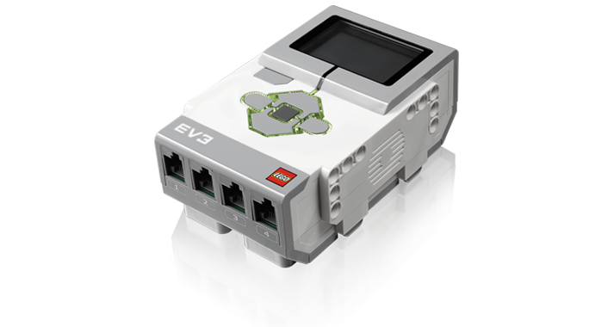
EV3 Brick
Notes:
This is the brain of the robot.
The inputs plug into the numbers.
The outputs plug into the letters.
Image Source: http://cache.lego.com/r/education/-/media/lego%20education/home/images/products/mindstorms%20ev3/45500_713x380_mainproduct.png?l.r=1276236109

Slide 18
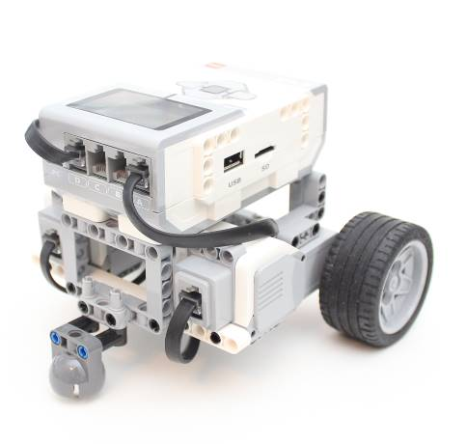
Build the Base Car
Follow the instructions in the Hands-on Robotics EV3 2 Project Instructions pdf

Slide 19
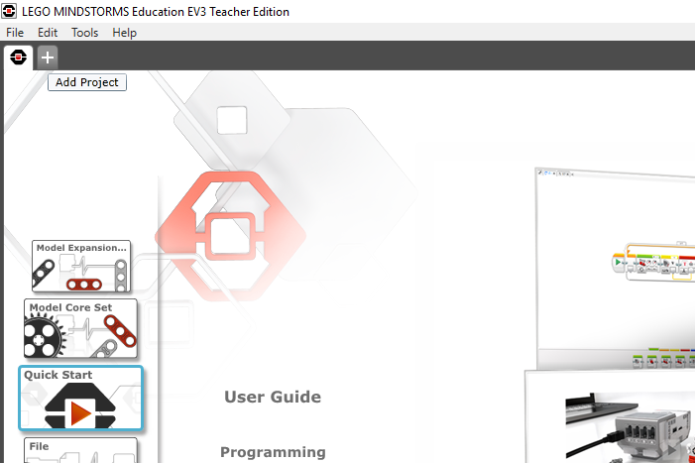

EV3 Software
Notes:
Click the plus sign to start a new project

Slide 20
One Motor
Large Motor Block

Slide 21
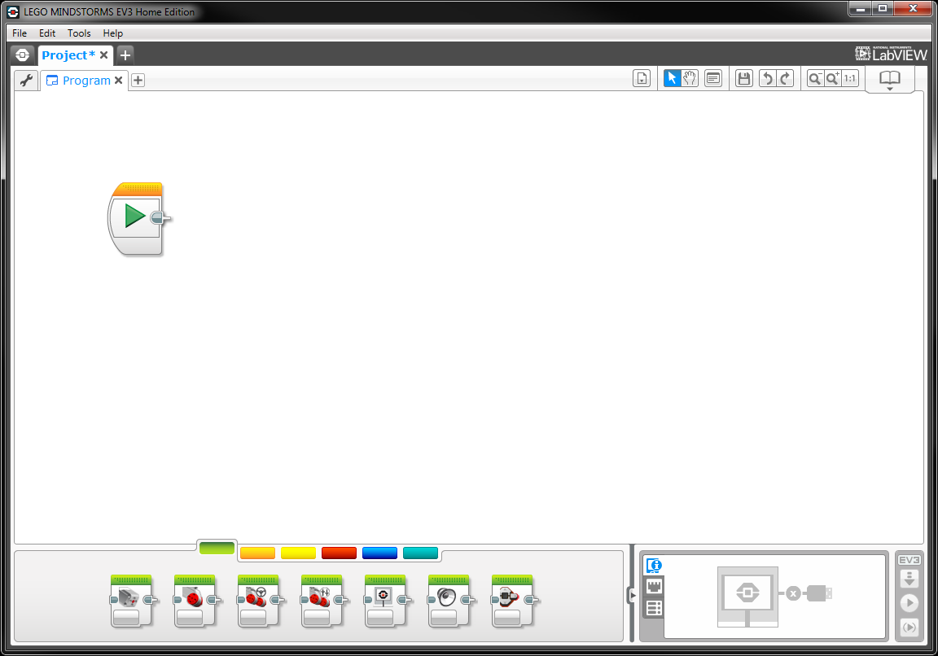
The Canvas
Notes:
Double click the name that appears on the project tab to rename the project

Slide 22
Large Motor
Notes:
What do we want our base car to do? We want it to move forward.
Let’s take a look at the 2nd block in the Action (green) category.

Slide 23
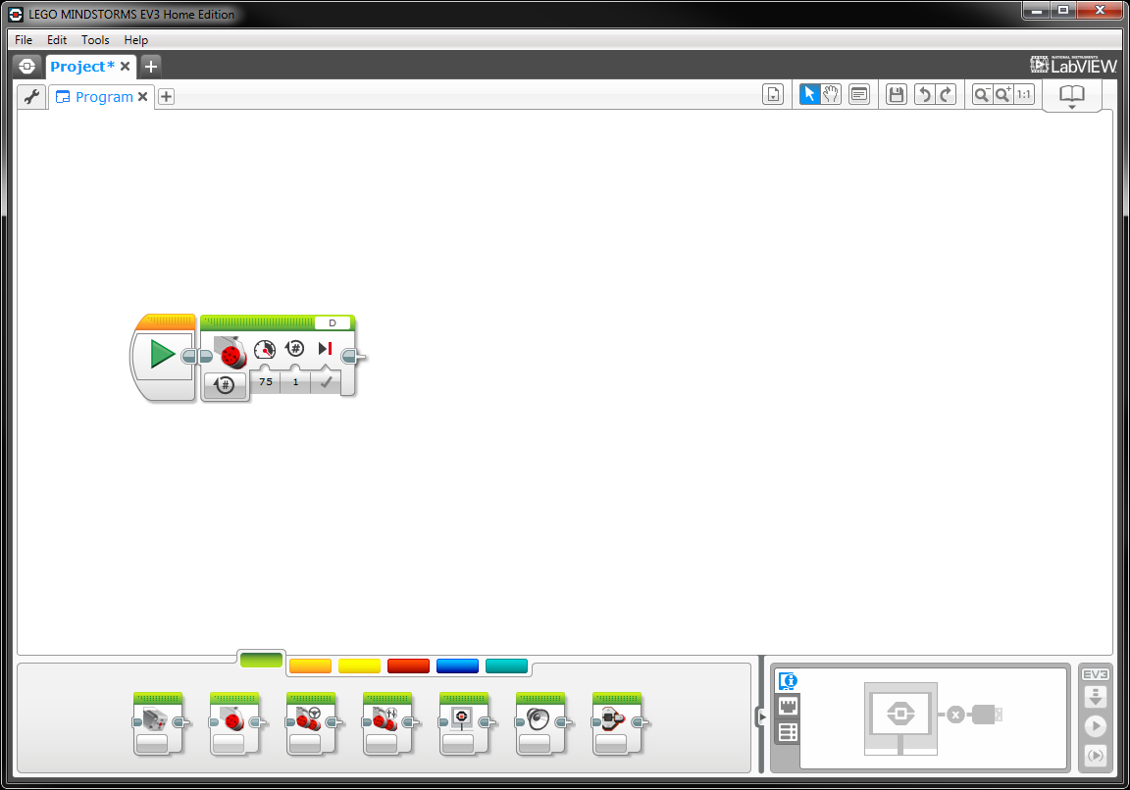
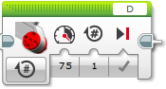
Large Motor
Notes:
Here we see a couple of things on the Large Motor block.
What do you think these are?
Answer: (From left to right) How to measure duration (infinite, time, rotations) , power, duration and next action. At the top right, there is also a selection for which port the motor is plugged into.

Slide 24
Two Motors
Move Steering Block

Slide 25
Move Steering
Notes:
Since we have two motors on our robot, we will use Move Steering. Click on the third button in the Action category, which is the move steering command, and drag it onto the start.
Why do you think we use this block instead of the Large Motor block?
Answer: Move Steering moves both motors at the same time.

Slide 26
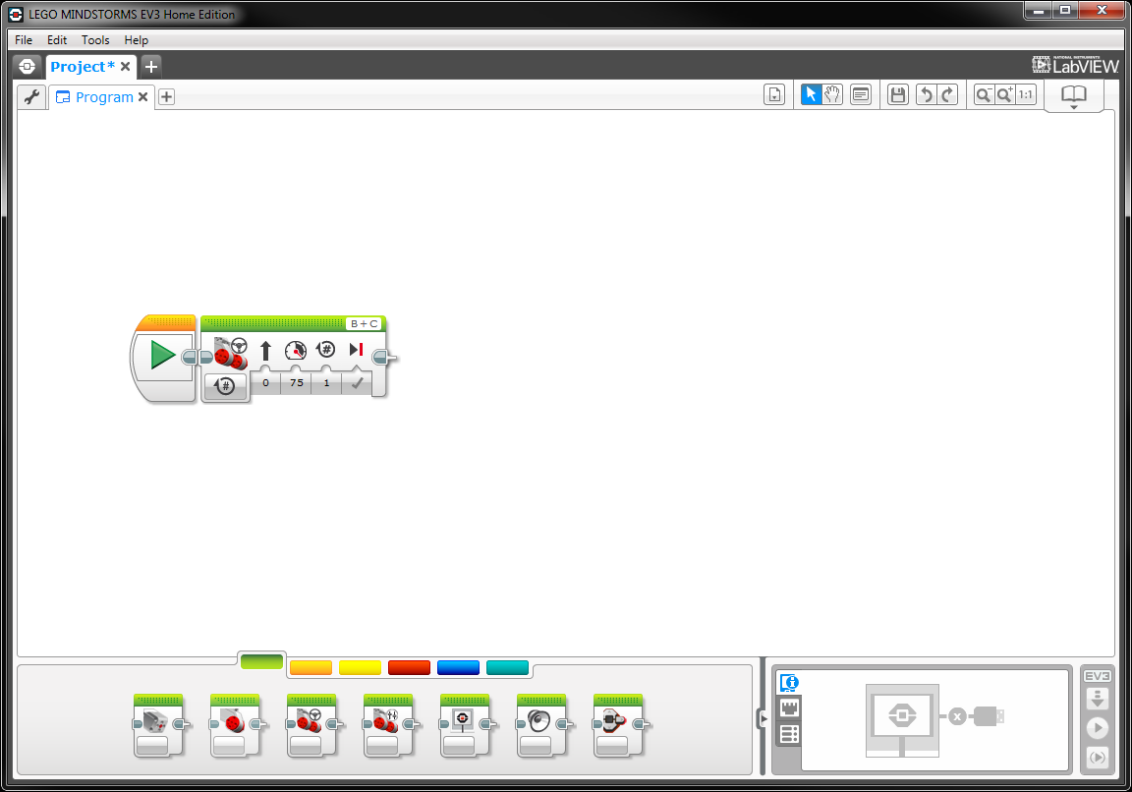
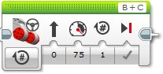
Move Steering
Notes:
Let’s take a closer look at the Move Steering block.
As we can see, the block looks very similar, we have the same settings such as how to measure duration, power, duration and next action.
The things we know that are different are steering and the motors selected. The steering setting allows us to choose which way the robot will go, turn left, turn right, go straight or spin on the spot. The motors selected right now show B + C because we have to select two motors. Think of B motor as the left motor and C motor as the right motor and when you use the slider for the steering setting, moving the slider left means turn towards motor B (left side) and moving the slider right means turn towards motor C (right side).

Slide 27
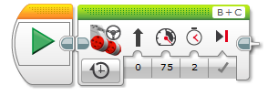
Activity 1
Make a program that will make the Base Car go forward for 2 seconds
Solution

Slide 28
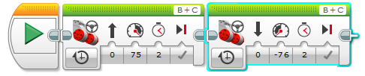
Activity 2
Make a program that will make the Base Car go forward for 2 seconds, then go backwards for 2 seconds
Solution
Notes:
The power needs to be changed to negative for the car to move backwards direction.

Slide 29
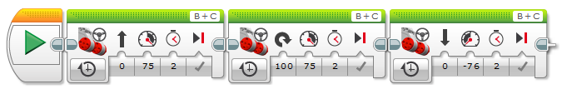
Activity 3
Make a program that will make the Base Car go forward for 2 seconds, turn around 180 degrees, then go forward for 2 seconds
Possible Solution:
Notes:
Answers may vary.
Common mistake: degrees set to 180 rotation – this is how much the motor turns, not how much the base car turns. Need to try out different values and test it out to see.
At this point, you can teach students how to connect and download onto their brick.

Slide 30
Activity 4
Make a program that will make the Base Car go in a square
Notes:
If there is time, continue with these challenges.
Solutions are trial and error.

Slide 31
Activity 5
Make a program that will make the Base Car go in a triangle
Notes:
If there is time, continue with these challenges.
Solutions are trial and error.

Slide 32
Activity 6
Make a program that will make the Base Car go in a pentagon
Notes:
If there is time, continue with these challenges.
Solutions are trial and error.

Slide 33
Activity 7
Make a program that will make the Base Car go in a hexagon
Notes:
If there is time, continue with these challenges.
Solutions are trial and error.

Slide 34
Activity 8
Make a program that will make the Base Car go in an octagon
Notes:
If there is time, continue with these challenges.
Solutions are trial and error.

Slide 35
Waits & Loops
Hands-on Robotics EV3 Level 2, Week 2

Slide 36
Review
Move Steering Block
Select Port
Choose Direction
Set Power
Set Duration
Brake at End

Slide 37
Wait
Wait Block

Slide 38
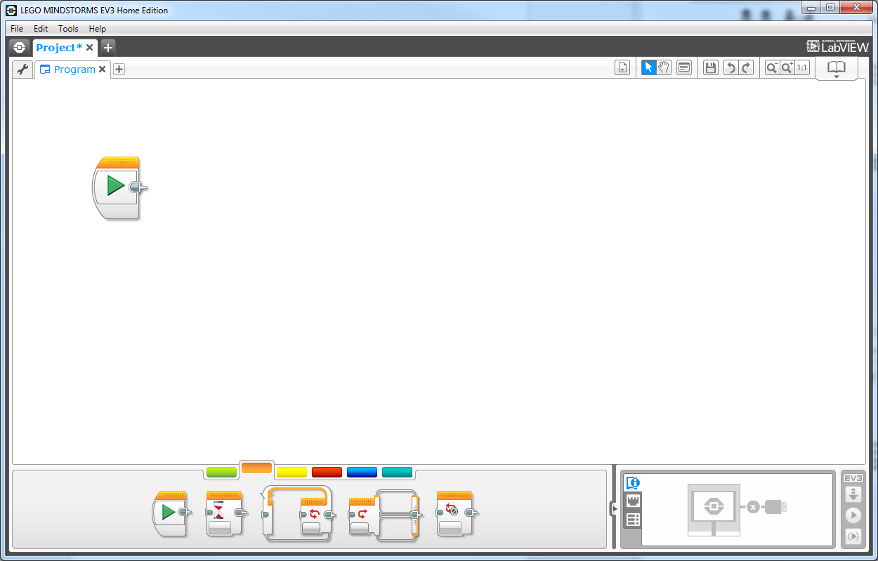
Wait
Notes:
Wait for a certain amount of time. Robot does nothing while it’s waiting
Other functions include waiting for some input from sensors.

Slide 39
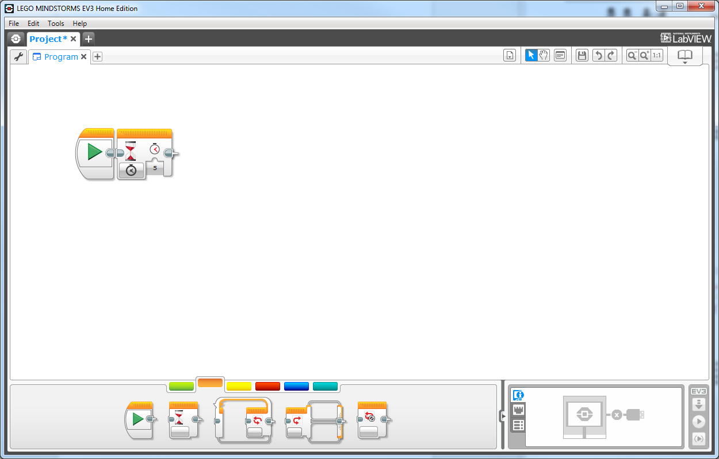
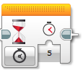
Wait

Slide 40
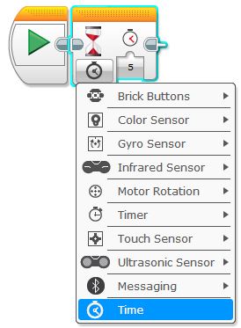
Wait
Wait Block
Wait for something
Time
Sensor (Next Week)
Notes:
Wait block pauses the program

Slide 41
Top Spinner
Build the Top Spinner from the Hands-on Robotics EV3 2 Project Instructions pdf
Make the following program for the Top Spinner
The program does nothing until the middle button is pressed
When the middle button is pressed, spin the motor for 5 seconds

Slide 42

Top Spinner Program Solution

Slide 43
Loop
Loop Block

Slide 44
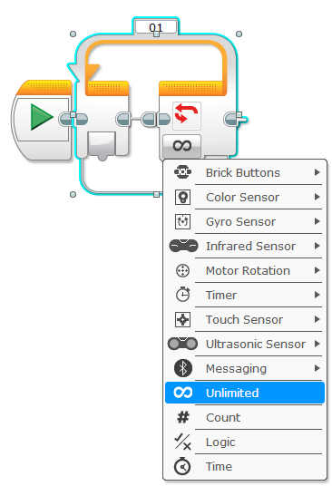
Loop
Loop Block
Repeat something
Unlimited
Count
Time
Sensors (Next Week)
Notes:
Can loop until a duration of time, number of times, or until a condition is met (true).
Can also loop unlimited.

Slide 45
Top Spinner
Make the following programs for your Top Spinner
A motor that keeps spinning, using a loop
A motor that keeps spinning, without a loop
Notes:
Without a loop, need to put a wait block at the end (doesn’t matter the settings, as long as not time). If not, the program will end right away.

Slide 46
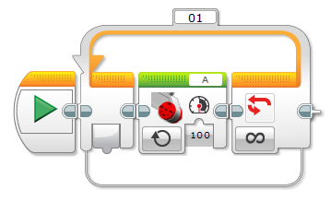
Top Spinner Solution (with a loop)
Notes:
Need solution without a loop

Slide 47
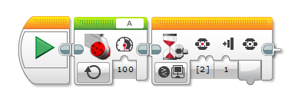
Top Spinner Solution (without a loop)
Notes:
Without a loop, need to put a wait block at the end (doesn’t matter the settings, as long as not time). If not, the program will end right away.

Slide 48
Sound Block & Sensors
Hands-on Robotics EV3 Level 2, Week 3

Slide 49
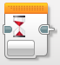

Review
Wait Block
Wait for sensor
Wait for time
Loop Block
Repeat things

Slide 50
Sound
Sound Block

Slide 51
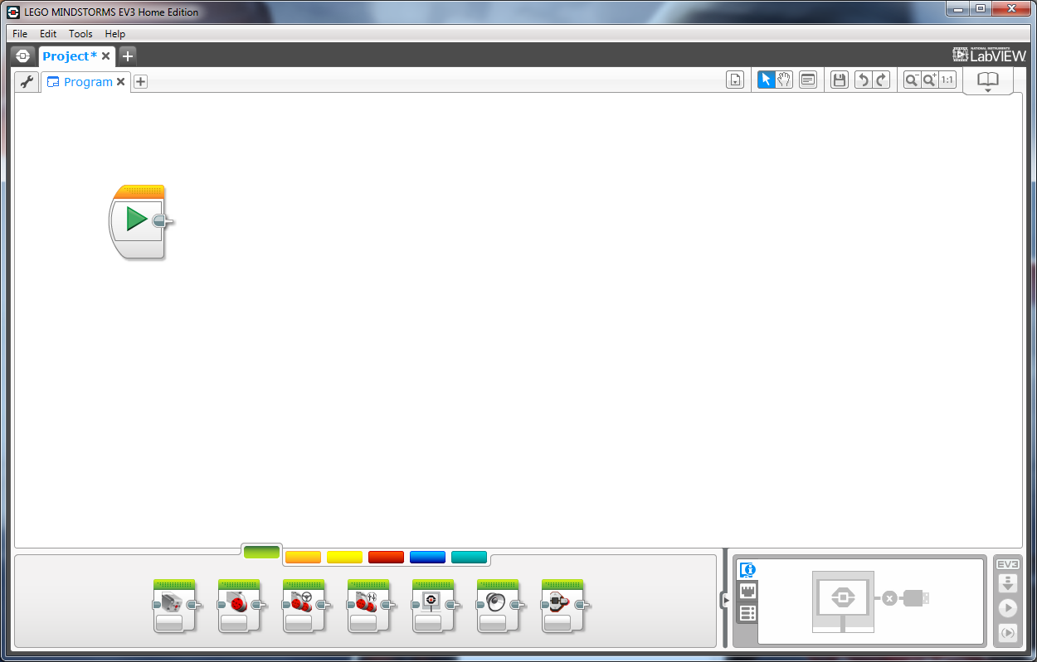
Sound Block

Slide 52
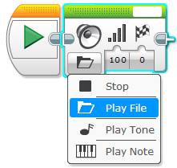
Sound Block
Notes:
File is just any file
Tones are different sounding beeps
Notes are musical notes
Volume.
Play until completion

Slide 53
BeatBox
Create a program that uses the tones/notes to play a song or a beat
You do not need to build anything for this activity
Notes:
Sample solution needed

Slide 54
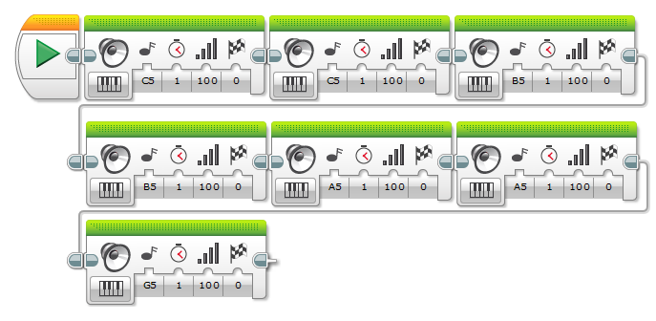
BeatBox Sample Solution

Slide 55
Sensors
Using Sensors

Slide 56
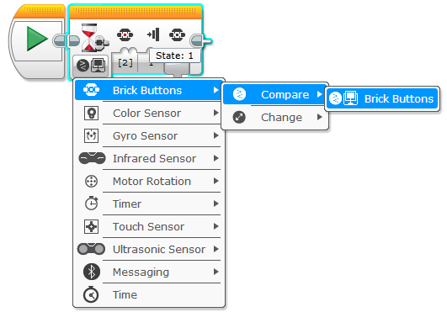
Sensors – Brick Buttons
Notes:
Can be used in wait block as well as loop.

Slide 57
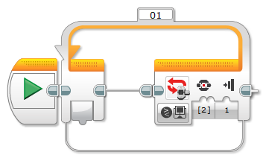
Sensors – Brick Buttons

Slide 58
Sound Board
Create a program that uses the buttons on the brick to play different sounds/notes/tones
Each of these buttons should play a different note:
Left button
Middle button
Right button

Slide 59
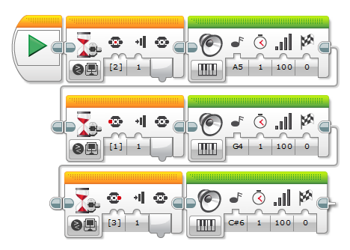
Sound Board Sample Solution
Notes:
Buttons need to be pressed in the right order for this to work.

Slide 60
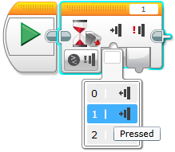
Sensors – Touch Sensor
Notes:
Also works with wait and loop blocks

Slide 61
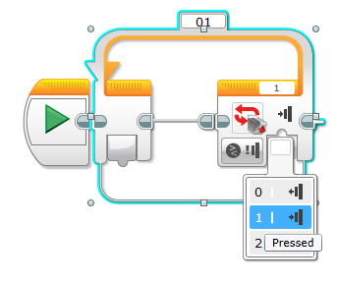
Sensors – Touch Sensor

Slide 62
Button Controlled Motor
Attach a touch sensor and a motor to the Brick
Create a program that will turn the motors when the touch sensor is pressed

Slide 63
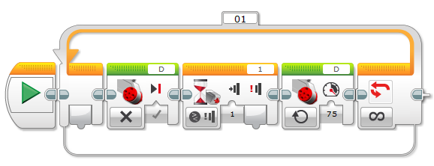
Button Controlled Motor Solution

Slide 64
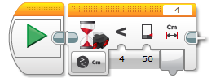
Sensors - Ultrasonic
Notes:
Instead of true or false, you have a comparison (e.g. closer/farther distance)

Slide 65
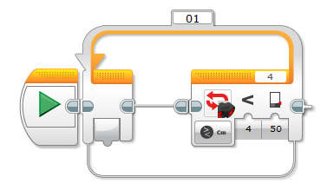
Sensors - Ultrasonic

Slide 66
Colour Sensor & Switches
Hands-on Robotics EV3 Level 2, Week 4

Slide 67
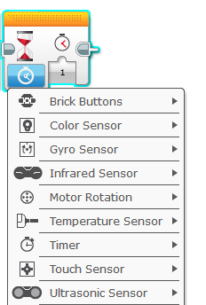
Review
Sound Block
Play a Note
Play a Tone
Play a File
Sensors
Button
Touch
Ultrasonic
Notes:
Gyro sensor?

Slide 68
Colour
Colour Sensor

Slide 69
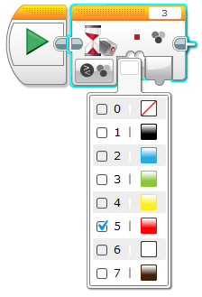
Sensors – Colour Sensor

Slide 70
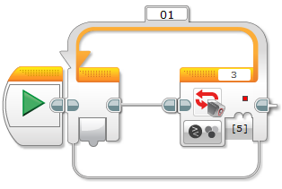
Sensors – Colour Sensor

Slide 71
Switches
If Statements

Slide 72
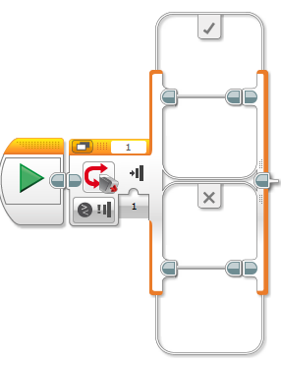
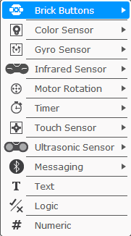
Switches

Slide 73
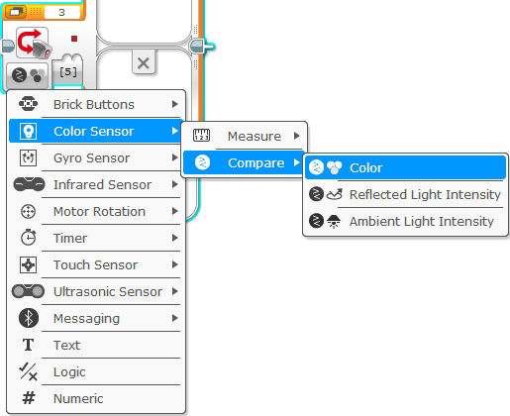
Switches
Notes:
Use compare for switches to compare the value with a value you want to test.

Slide 74
Colour Scanner
Build the Colour Scanner from the Hands-on Robotics EV3 2 Project Instructions pdf
Program the Colour Scanner to do the following:
Detect blue
Play a sound
Keep running until you stop the program

Slide 75
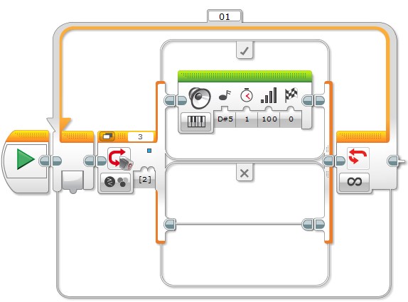
Colour Scanner Solution

Slide 76
Buffalo Bumper Car & Door Alarm
Hands-on Robotics EV3 Level 2, Week 5

Slide 77

Review
Colour Sensor
Scan for colour
Switches
Used to make decisions in programming

Slide 78
Buffalo Bumper Car
Build the Buffalo Bumper Car from the Hands-on Robotics EV3 2 Project Instructions pdf
Program the Bumper Car to do the following:
Detect hitting something
Backup and turn
Go forward if not hitting something

Slide 79
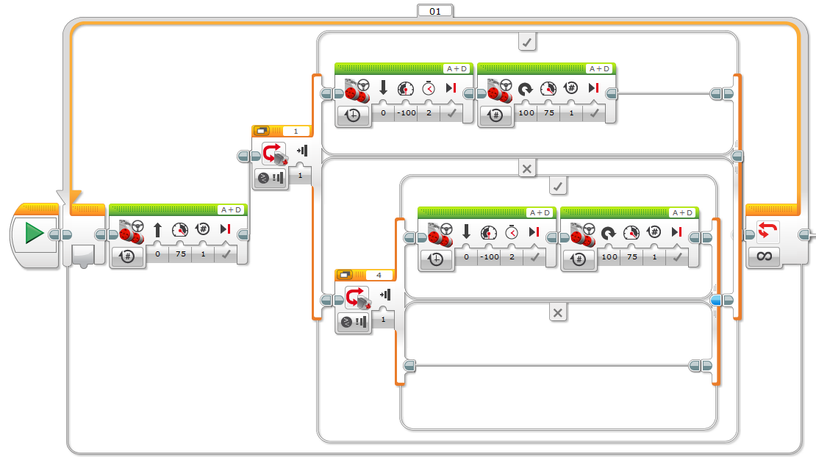
Buffalo Bumper Car Solution

Slide 80
Door Alarm
Build a Door Alarm
Secure the Ultrasonic Sensor to the Brick
Plug the Ultrasonic Sensor into Port 4
Program the Door Alarm so that it does the following:
Detect when someone gets closer than 30 cm
Play any sound/tone/note 3 times when detected

Slide 81
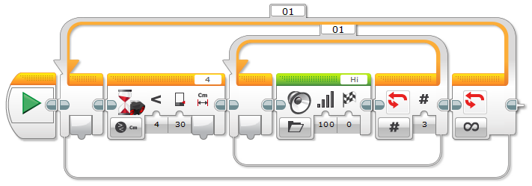
Door Alarm Solution

Slide 82
My Block & Mini Rover
Hands-on Robotics EV3 Level 2, Week 6

Slide 83
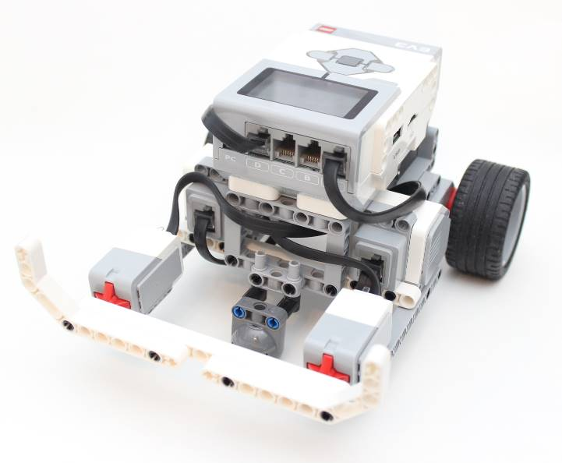
Review
Buffalo Bumper Car
Switches
Loop
Door Alarm
Loop
Switch

Slide 84
My Block
My Block

Slide 85
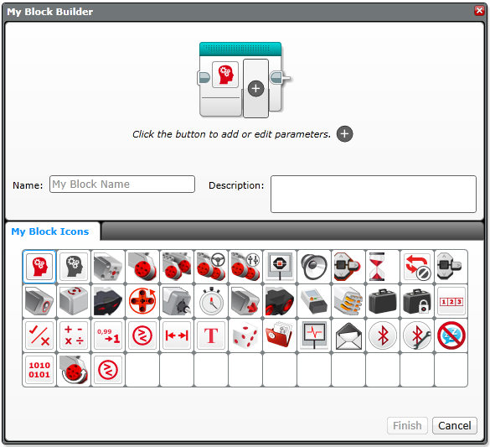
My Block
Custom Block
Can add other blocks
Useful for long tasks

Slide 86
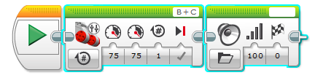
My Block
Notes:
What is My Block
Highlight the blocks you want in the My Block

Slide 87
My Block

Slide 88
My Block

Slide 89
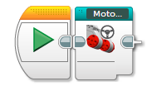
My Block

Slide 90
Mini Rover
Build the Mini Rover from the Hands-on Robotics EV3 2 Project Instructions pdf
Program the Mini Rover
Control the rover using the Brick
Left button turns left
Middle button goes straight
Right button turns right

Slide 91
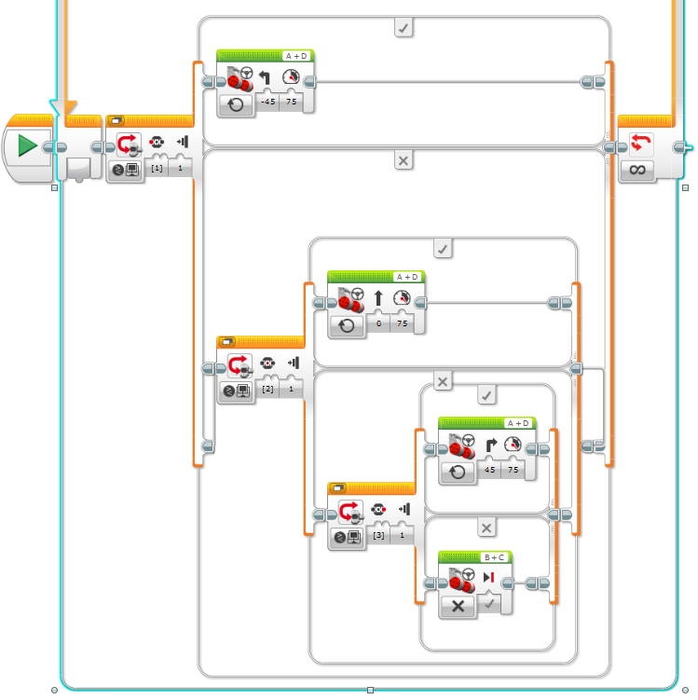
Mini Rover Solution

Slide 92
Mini Golf & Challenge
Hands-on Robotics EV3 Level 2, Week 7

Slide 93
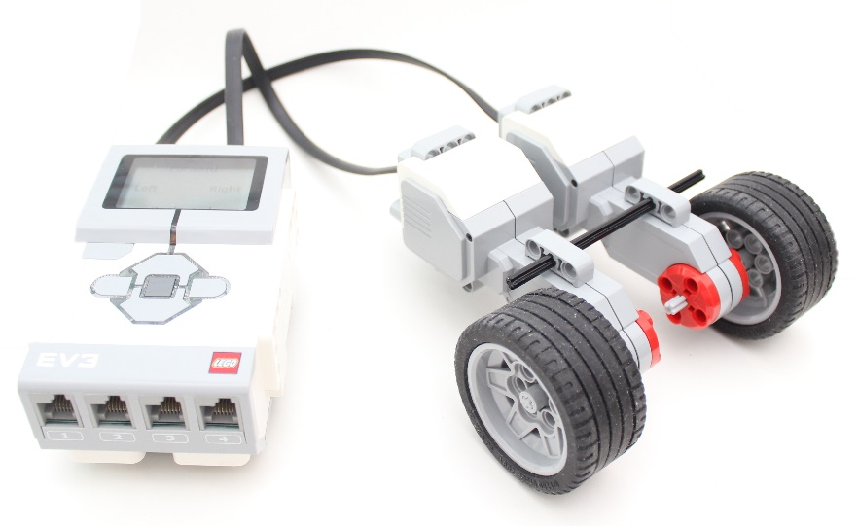
Review
My Block
Mini Rover
Switch

Slide 94
Mini Golf
Build the Mini Golf from the Hands-on Robotics EV3 2 Project Instructions pdf
Program the Mini Golf
Left button swings soft
Middle button swings medium
Right button swings hard

Slide 95
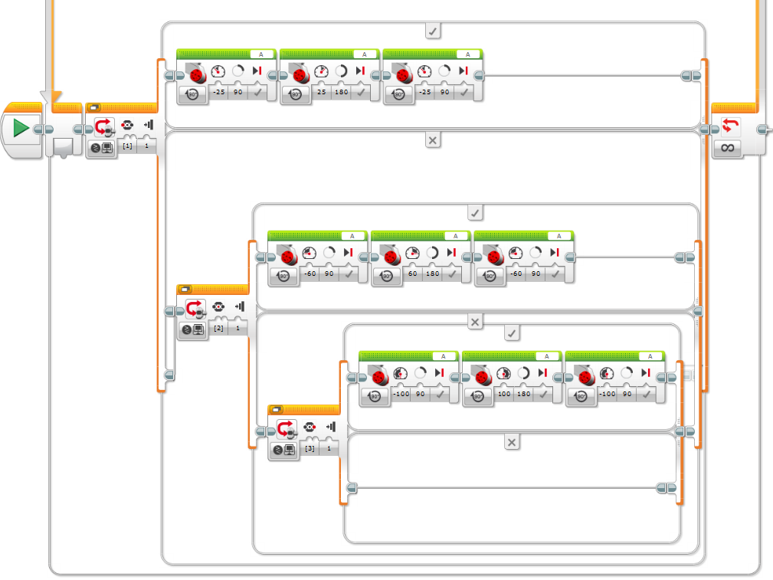
Mini Golf Solution

Slide 96
Challenge!
Choose one of the projects we have done before from the Hands-on Robotics EV3 2 Project Instructions pdf
Create a My Block to use in the program
Feel free to add sounds, display, or your own personal touch to the programs

Slide 97
Final Project
Hands-on Robotics EV3 Level 2, Week 8

Slide 98
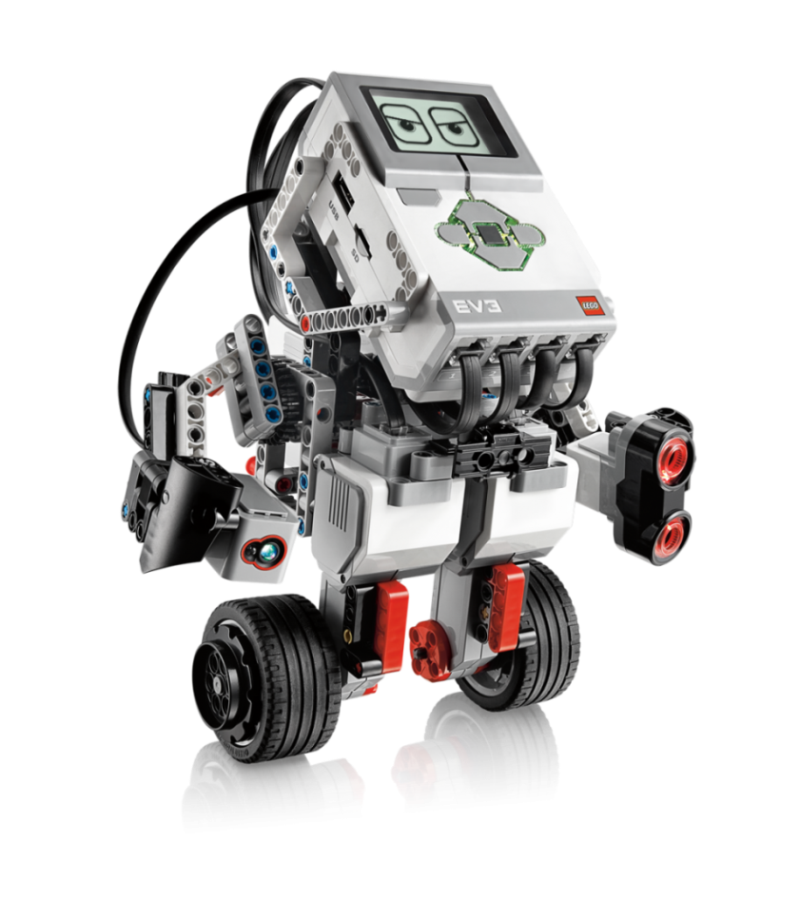
Final Project – Design a Robot
Design your very own robot
Plan how you want it to look
Build the robot
Make sure to include sensors and motors to the program
Be creative!
Program the robot
Use at least 7 blocks
Notes:
Image Source: http://www.erichuang.com/uploads/1/4/8/2/14828090/652998426_orig.png?294
Out of 10
7 blocks
At least 1 sensor
At least 1 motor
Creativity

